Slide 1

A Beginner's Guide TO
“APA PAPER and REFERENCING FORMAT”
Presenter:
Hasanuzzaman Tushar, PhD

Slide 2

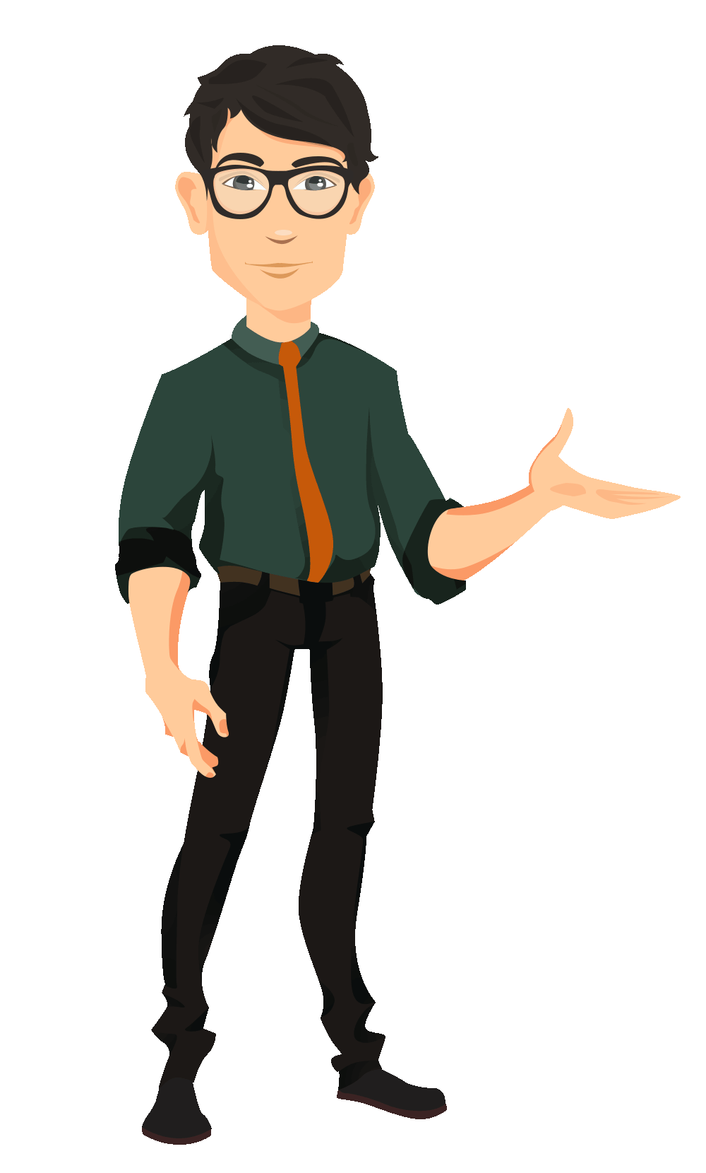
Presentation outline
1
1. Overview of APA Format
2. Why should we use?
3. Discussion of Sample Guidelines
4. Citations and References
5. Questions and Answers

Slide 3

What is APA?
Overview of APA Format
APA = American Psychological Association
Promotes guidelines for preparing research papers and projects and scholarly manuscripts in the social and behavioral sciences
“APA style” refers to a system of citing research sources

Slide 4

Overview of APA Format
“Provides guidelines for preparing research papers and projects and scholarly manuscripts in the social and behavioral sciences”
Why should students use APA format?
To prepare a clear and quality report
Credibility as a writer
To develop and practice a central report format
To avoid and reduce plagiarism
APA Format
Notes:
A Top 20 Leadership Training Company that’s home to award-winning courses that enable organizations to achieve new levels of performance by changing employee behavior.

Slide 5

General Manuscript Structure and Content
Title page
Abstract
Introduction
Review of the literature
Methods
Results
Discussion
Conclusion
References
Appendices and Supplemental Materials

Slide 6


ALL CAPS SHORT TITLE 50 CHARACTERS OR LESS
1
The title on the first page is centered, double-spaced, and not bold

Slide 7
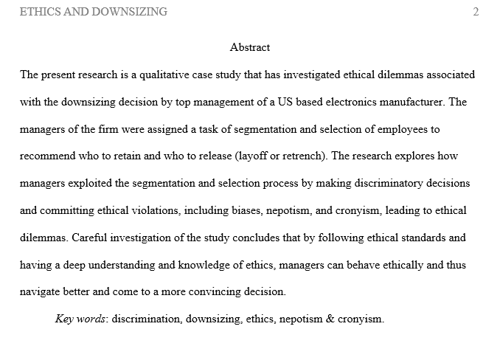
“Abstract” is centered
A single paragraph
Without indentation
Times New Roman
Double Spaced
Key words

Slide 8
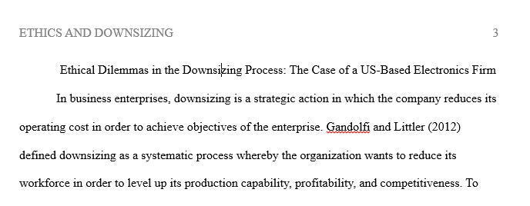
Title of paper gets repeated here exactly as it appears on the first page
Times New Roman, 12-point font, doubled spaced, and aligned left.
Paper size is A4 with page margins set to 2.5 cm all round.
Each new paragraph is indented by 0.5”.
“The introduction to a manuscript does not carry a heading that labels it as the introduction” (APA, 2013, p. 63).

Slide 9
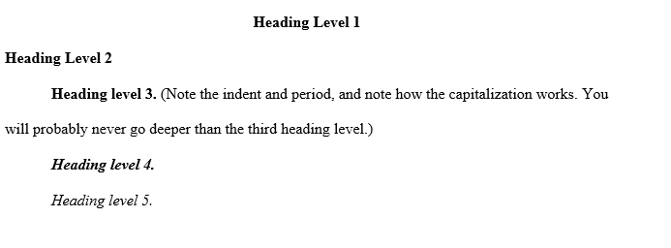
The major components of your report/ paper (abstract, body, references, appendix etc.) each begin on a new page.
These components (Heading 1) begin with centered headings at the top of the first page.
Heading 2: without indentation, para with indentation by 0.5”.
Heading 3,4,5…: capitalization will be sentence case, indented by 0.5”, and para will start after the heading period.
Example: http://www.apastyle.org/manual/related/sample-experiment-paper-1.pdf

Slide 10
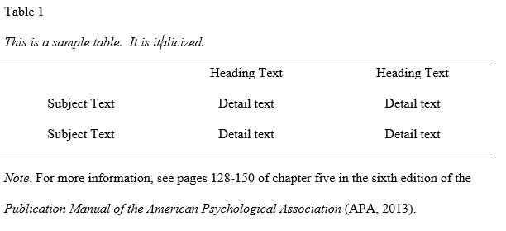
Formatting Tables

Slide 11
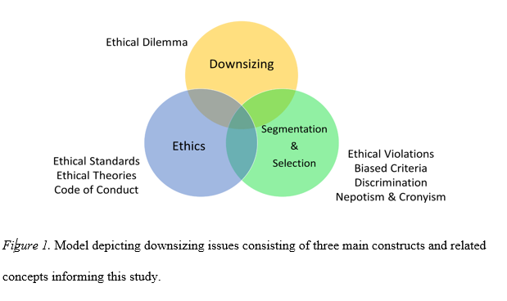
Formatting Figures

Slide 12


Citations and References
Many students plagiarize unintentionally. Whenever you summarize, paraphrase or quote another author's material you must properly credit your source.
If you are using another person’s idea, you should also cite source!
One of my parents always said, “Don’t wet your bed” (Mom, 1990).

Slide 13
Why Should I Cite?
1. Citing identifies sources used in a research paper or project
2. It gives credit to those researchers, authors, and writers whose words or ideas you borrow, acknowledging their role in shaping your research.
3. It allows others to follow-up on or retrieve this material
4. To avoid charges of plagiarism

Slide 14
What is Plagiarism?
Plagiarism is:
The unacknowledged use or appropriation of another person’s words or ideas
A form of cheating or stealing
A serious academic offense
When you borrow words or ideas from sources to support your argument or research you must give proper credit. By crediting your sources, you avoid plagiarism. If you do not cite a source--intentionally or unintentionally--you are guilty of plagiarism.

Slide 15
How Do I Cite?
There are two parts to citing according to APA style:
1. In-text citations (often in parentheses) within the body of your essay or paper
2. List of full citations in the References page at the end of your paper
Note:
Sources cited in the text must appear in the References page.
Conversely, each entry in the References page must be cited in the text.

Slide 16
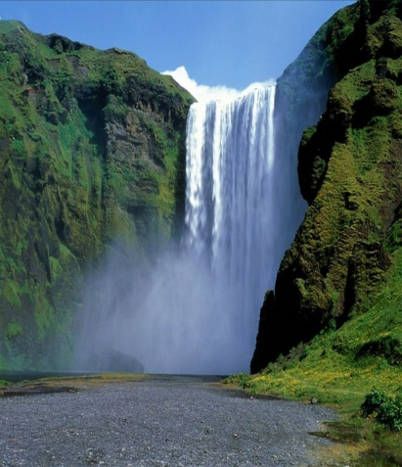
APA provides these guidelines for citations:
In-text citations:
“References . . . are cited in text with an author-date . . . and are listed alphabetically in the reference list” (Publication Manual, 2010).
Reference list citations:
“Choose references judiciously . . . [and] reference data must be correct and complete” (Publication Manual, 2009).

Slide 17


In-Text Citations
You must provide information that will allow the reader to locate exactly where you found information in your sources. Usually this is the author's last name and the year of publication, for example: (Wasser, 2009)
Place the parenthetical reference at the end of the sentence before the punctuation mark.
  Bedwetting emissions have been determined to consist mostly of two parts hydrogen to one part oxygen, plus assorted diurnal chemicals (Wasser, 2009).

Slide 18
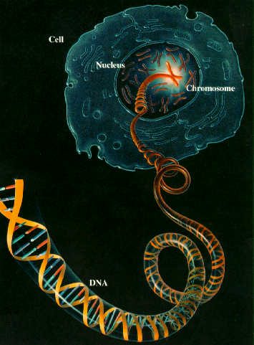
In-Text Citations, Cont’d
When the author's name appears as part of your sentence (known as a “signal phrase”), do not use it again in the parenthetical citation. Just give the year of publication:
  Wasser (2009) argues that bedwetting is
  ultimately a genetically predisposed behavior.
When there are two authors, name both authors every time their work is referenced in your paper:
  Among epidemiological samples, Selbst and Tikling (2008) found that early onset social anxiety disorder results from adverse parental responses to bedwetting.
  The study also showed that there was a high rate of alcohol and drug abuse associated with unresolved bedwetting issues (Selbst and Tikling, 2008).

Slide 19
Other Citation Possibilities
When there are between 3 and 5 authors, name all at their first citing, including the year of publication. At subsequent citings in your paper, retain only the first author and replace the others with “et al.”:
Selbst, Tikling, Wang, Getz, and Wasser (2009) believe that bedwetters have a genetic predisposition for their behaviors.
In work with the Human Genome Project, Selbst et al. (2009) have identified the unique gene that contributes to bedwetting propensity.
When there are 6 or more authors, use first author’s surname and “et al.” for the others as in second example above in all citing instances.
If the author is a group (e.g., corporation, association, government agency), use the entire name in your in-text cite, though some groups’ names can be abbreviated after the first instance:
According to government figures, boys are 35% more likely across the socio-economic spectrum than girls to wet their beds (National Institute of Mental Health, 2000). Next instance: (NIMH, 2000)
When a work has no identified author, cite in text the first few words of the reference list entry; if article, chapter or web page, use quotation marks, if periodical, book, report, use italics:
Bedwetters also wet couches (“IKEA Report,” 2005)
A popular college prep handbook, College Bound Seniors (2008), recommends use of the upper bunk if your roommate is a bed-wetter.
Cite as you normally would and
separate citations with a semicolon
When possible, give only the last
two digits for the second number
Author Comma Title Page Number

Slide 20
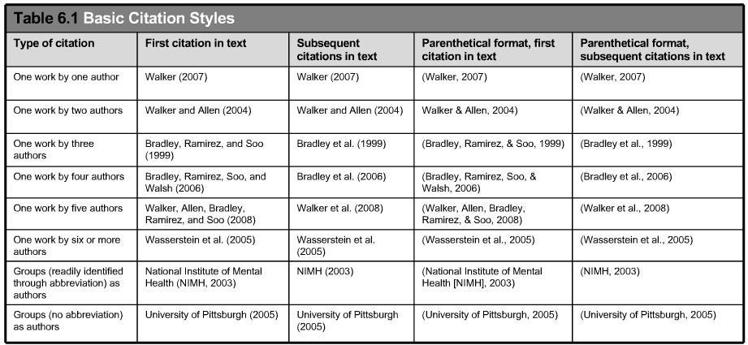
In-text citations
Source: Publication Manual of APA, page 177

Slide 21
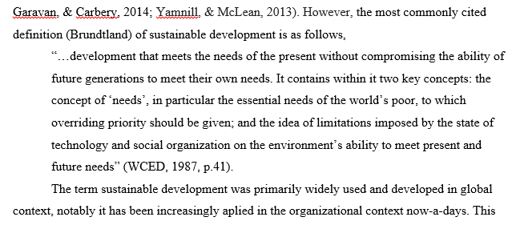
Quotation
When students directly copy a sentence or para, must need to provide quotation mark “…..” with page/para no in text.
  Eg: “Researchers do not claim the words and ideas of another as their own” (APA, 2013, p. 15).
Any passage with word-length of 40 and above need to be treated differently.
  Start such a block quotation on a new line and indent the block about a half inch from the left margin and at the end provide page/para no.

Slide 22


In-text Citing of Electronic Sources
Treat electronic sources the same as print sources.
Direct quotations from e-sources which don’t have page numbers are referenced by paragraph or heading and paragraph number, if available:
Eiberg, Berendt, and Mohr (1995) concluded in a Danish study that “nocturnal enuresis, or nightly bedwetting in children more than seven years of age affects about 10% of seven-year-old children, with a wide range of frequencies between populations” (para. 4).
A recent Italian study found that “the prevalence of enuresis was higher when the child was from a family of low socio-economic status despite the child's age group” (Chiozza et al., 2002, “Results,” para 3). [This source has > 6 authors (in fact, 8), so ‘et al.’ is used for all authors after the first named author.]

Slide 23
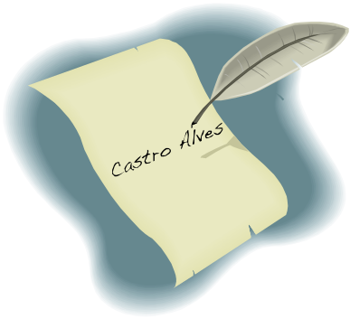
References List
The References list appears at the end of your paper on its own page.
Everything you referenced in your text must be listed in your References list .
Conversely, everything you list in the References list must be cited in your essay.
The References list provides the information needed for a reader to find and retrieve any source used in your paper.

Slide 24
General Tips: Print Resources
Author’s last name first, then his first (and middle) name(s) abbreviated.
Camplone, A.
If more than one author, but no more than six, list all authors, separated by a comma, and connecting the last with an ampersand:
Schulman, S. L., Colish, Y., von Zuben, F. C., & Kodman-Jones, C.
Titles of books and periodicals are italicized and only the first word in title and after a colon and proper nouns are capitalized:
Water world: Enuresis, the wet and dry of it.
Clinical Pediatrics
Article and chapter titles appear in regular font with same rules for capitalization:
To treat bed-wetting, healthy doses of patience.

Slide 25

Book Examples
With one author:
Seligman, L. (1999). Selecting effective treatments: A comprehensive, systematic guide to treating mental disorders. San Francisco: Jossey-Bass.
With three to six authors:
Tikling, S. F., Avulsion, D. T., Bonds, B., & Huckabee, T. S. (2008). Unstoppable leakages: Every child deserves plumbing. Lanham, MD: Rowman & Littlefield.
Italicize title of book
Use a colon between the
main title and the subtitle
List all authors Last Name in full, then first
(and middle) name(s) abbreviated
Publisher’s name
If city of publication is not well-known, add state postal code
Remember to indent all lines after the first line ½ inch
Date of publication in parentheses, followed by a period

Slide 26


Articles
Journal article with doi:
Farley, H. W., Long, H., & Short, M. (2008). The scientific case for modern anthropogenic causes for
enlarged prostate due to childhood enuresis in adult males. Monthly Review, 60(3), 68-90.
doi:10.1037/0735-7036.122.116.
Magazine:
Manthorpe, C, Womening, M., Evadam, J., & Biternatura, L. (2009, May). "Feminists look at the scienc of enuretic doppelgangers. New Scientist 85(3), 29-31.
Newspaper:
Tilgham, S. M. (2009, September 30). Science vs. women--a radical solution. New York Times, pp. F1, F5.
Issue # in parentheses
Dates: For journals, year; for magazine, month and if applicable, week; for daily newspaper, date. Note Formats: YYYY, MMM, DD.
Periodical titles in italics
Volume numbers in italics
In a newspaper article reference, use “pp.” if more than one page, “p.” if only a single page.

Slide 27

Websites
Joyce, J., Dedalus, S., Bloom, L., & Bloom, M. (2009). Chiastic structure and its affect on Mobius strips, Escher prints, and enuretic behaviors of gimpy gertys. HyperJoyce Studies. Hypermedia Joyce Studies, 10. Retrieved from http://hjs.ff.cuni.cz/main/essays.php?essay=joyce
Yee, P., & Yee, K. (2008). Climatological impacts on and fractal patterns of urinal stains. U.S. Environmental Protection Agency. Retrieved from http://www.epa.gov

Slide 28
Other Sources
Other sources can also be used
and cited
Technical & research reports
Meetings & symposia
Doctoral dissertations & master’s theses
Audiovisual media
Data sets, software, measurement instruments, and apparatus
Internet messages boards, electronic mailing lists, online communities

Slide 29
Other Sources
What Should Be Included?
Technical reports:
Browning, R. & Barrett, E. (2006). Romantic auras and enuretic halos (Report No. 1869). Devonshire, England.
National Institute of Mental Health. Task Force on Female Enenurism. (2008). Report on the sexualization of prepubscent girls diagnosed with enurism. Retreived from http://www.nimh.gov/taskforceenurism/sexualization
Meetings & symposia, published proceedings:
Hegel, J., Bach, J. S., & Maeterninck, F. (2008, May). Dialectics, atonal harmony, francophile politics and interdisciplinary enuretics. In Godel, J. (Chair), 109th Symposium of Enuretics Anonymous. Symposium conducted at the meeting of Enuretics Anonymous, Thailand.

Slide 30
Other Sources
What Should Be Included?
Cont’d
Doctoral dissertations:
Wannabee, R. J. (1996). Bedwetters and broomsticks: An inquiry into discipline and enurism (Master’s thesis). Retrieved from University Microfilms. (Accession No. 192883-96)
Audiovisual Media, video:
Hitchcock, A. (Director). (1957). Rear window on enuretic behavior among adults [DVD]. Available from Universal Studios.
Internet message boards, electronic mailing lists, and online communities—blog post:
Jobs, S. (2010, June 6). I-phone 4 and enuretic ring tones [Web log comment]. Retrieved from http://www.apple.com/newproducts/iphone/4/php

Slide 31

Generating References
By using Software
  Mendeley
  Zotero
  EndNote
  RefWorks
  LaTex and BibTex
Manually
  Microsoft Word
  Google Scholar
  Citation and Reference generator Websites

Slide 32
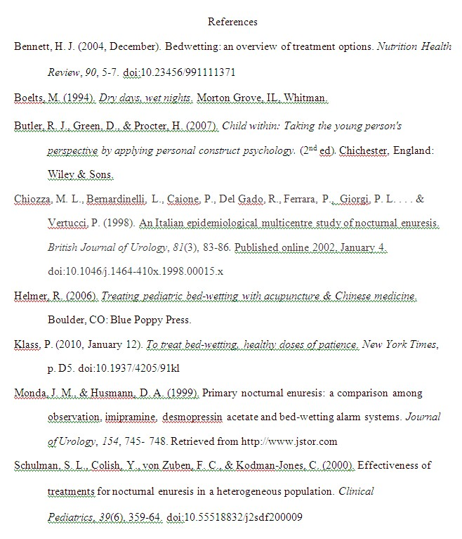
Sample References Page
*Sources are listed alphabetically
Title “References” is centered
at the top of the page
Be sure to include the digital object identifier (doi), if the source has one
Indent all lines after
the first ½ inch for
each reference
listed
*The entire References page is double-spaced
All citations end in a period (.), except those with a doi or URL
*All papers in APA style must be in 12-pt., Times New Roman font

Slide 33

The APA ‘Bible’
If you come across anything not mentioned in this presentation or need further information, take help from the Publication Manual of the APA!
Publication manual of the American Psychological Association. (2013.) 6th ed. Washington, DC: American Psychological Association.

Slide 34


